Slide 1
PREPARATION FOR FULL VENEER CROWN
RUNGTA COLLEGE OF DENTAL SCIENCES AND RESEARCH
BY- DR RUCHA KASHYAP

Slide 2
CONENTS
INTRODUCTION
CLASSIFICATION
ADVANTAGE/ DIS ADVANTAGE
INDIACATION/ CONTRAINDICATION
SELECTION OF ABUTMENT TEETH
TYPES OF ATTCHMENTS
SUMMARY
TAKE HOME MESSAGE
REFERENCES

Slide 3
SPECIFIC LEARNING OBJECTIVES
SR.NO | CORE AREA | DOMAIN | CATEGORY
1. | INTRODUCTION CLASSIFICATION | Cognitive | Must Know
2. | ADVANTAGE/ DIS ADVANTAGE INDIACATION/ CONTRAINDICATION SELECTION OF ABUTMENT TEETH TYPES OF ATTCHMENTS | Cognitive | Must Know
3. | SUMMARY | Affirmative | Must Know

Slide 4
INTRODUCTION
FULL COVERAGE OF TEETH WITH AN ARTIFICIAL CROWN IS KNOWN AS “FULL VENEER CROWN”
IT HAS 50% MORE RETENTION AND RESISTANCE THAN PARTIAL VENEER CROWN
IT INVOLVES FULL CERAMIC,METAL CERAMIC AND CAST CROWN RESTORATION
A DENTAL SURVEY DATA IN 1979 INDICATED THAT 93% OF CAST RESTORATIONS DONE BY DENTISTS WERE FULL COVERAGE RESTORATION

Slide 5
TYPES OF FULL COVERAGE RESTORATION
1)THE COMPLETE CAST CROWN RESTORATION
2)METAL CERAMIC RESTORATION
3)ALL CERAMIC RESTORATION

Slide 6
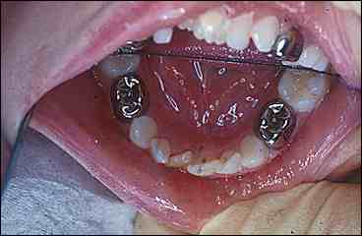
THE COMPLETE CAST CROWN

Slide 7
ALL CERAMIC CROWN

Slide 8
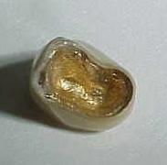
METAL CERAMIC CROWN

Slide 9
THE COMPLETE CAST CROWN RESTORATION
INDICATIONS
CONTRAINDICATIONS
ADVANTAGES
DISADVANTAGES
METHOD OF PREPARATIOPN

Slide 10
INDICATIONS
1)TEETH EXTREMELY DESTROYED BY CARIES,TRAUMA OR DECALCIFICATION
2)IT IS USED WHEN MAXIMUM RETENTION AND RESISTANCE IS NEEDED
3)WHEN AXIAL CONTOUR CANNOT BE CORRECTED BY CONSERVATIVE TREATMENT
4)USED TO SUPPORT REMOVABLE PARTIAL DENTURE BY ALLOWING PREPARATION OF GUIDEPLANES,RESTS AND SURVEYLINES
5)USED TO COMPENSATE A WEAK ENDODONTICALLY TREATED TEETH

Slide 11
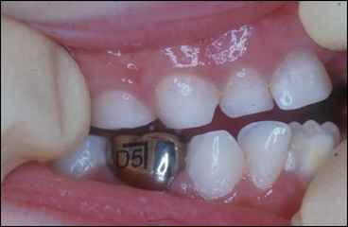

Slide 12
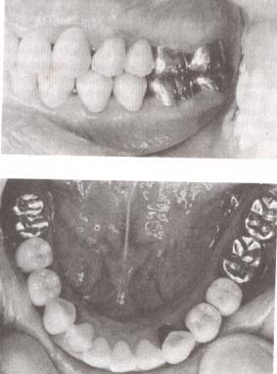
COMPLETE CAST CROWNS USED TO RESTORE MOLAR TEETH(note it is not used in canine or premolars for esthetic reasons)

Slide 13
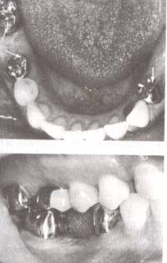
COMPLETE CROWNS USED AS RETAINERS TO ACCOMMODATE A MANDIBULAR REMOVABLE PARTIAL DENTURE

Slide 14
CONTRAINDICATIONS
1)TO PRESERVE AXIAL WALLS WHEN BUCCAL AND LINGUAL WALLS ARE PRESENT(USE PARTIAL COVERAGE RESTORATION)
2)IF LESS THAN MAXIMUM RETENTION AND RESISTANCE IS NEEDED(short span fpd)
3)IF CORRECT BUCCAL CONTOUR CAN BE OBTAINED BY ENAMELOPLASTY
4)WHERE HIGH ESTHETICS IS NEEDED

Slide 15
ADVANTAGE
1)MORE RETENTION AS IT INVOLVES ALL THE AXIAL WALLS
2)MORE RESISTANCE AS ALL THE WALLS ARE PREPARED WITH SUFFICIENT TAPER TO RESIST TORQUE
3)STRENGTH IS SUPERIOR AS IT ENCIRCLES COMPLETE CROWN(cylindrical configeration)
4)MAL ALIGNED TEETH ENABLES RECOUNTOURING
5)RECOUNTOURING OF BUCCAL AND LINGUAL WALLS GIVE ACCESS TO FURCATION AREA
6)MODIFICATIONS IN CAST CROWNS ALLOWS RETENTION OF RPD

Slide 16
DISADVANTAGE
1)PREPARATION INVOLVES LOSS OF LARGE AMOUNT OF TOOTH STRUCTURE
2)APPROXIMATION TO GINGIVAE CAUSES INFLAMMATION OF GINGIVAE AND ILL FITTING CAST CROWN
3)CONDUCTIVITY OF THE CAST METAL INTERFERES WITH ELECTRIC PULP TESTING
4)PATIENTS MAY NOT LIKE TO DISPLAY METAL IN NORMAL SMILE LINE

Slide 17
CRITERIA
1)OCCLUSAL REDUCTION TO ALLOW ADEQUATE SPACE FOR CAST CROWN RESTORATION
2)AXIAL REDUCTION PARALLEL TO LONG AXIS OF TEETH WITH 6 DEGREE TAPER OF AXIAL WALLS
3)SUPRAGINGIVAL SMOOTH CONTINOUS CHAMFER OF .5mm THICKNESS

Slide 18
SPECIAL CONSIDERATIONS
1)FUNCTIONAL (centric)CUSP BEVEL
2)NONFUNCTIONAL (noncentric cusp )BEVEL
3)CHAMFER WIDTH

Slide 19
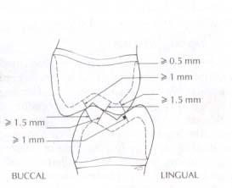
FUNCTIONAL AND NON FUNCTIONAL CUSP BEVEL(CENTRIC CUSP)

Slide 20
STEPS IN CROWN PREPARATION
1)OCCLUSAL GUIDING GROOVES
2)OCCLUSAL REDUCTION
3)AXIAL ALIGNMENT GROOVES(buccal and lingual)
4)AXIAL REDUCTION
5)PROXIMAL REDUCTION
5)FINISHING AND EVALUATION

Slide 21
ARMAMENTARIUM
ROUND ENDED TAPERED DIAMOND BUR(occlusal and axial guiding grooves,axial reduction,chamfer preparation)
FLAT ENDED TAPERED BUR(axial reduction,shoulder)
TORPEDO DIAMOND(axial reduction,chamfer finish line)
NEEDLE DIAMOND BUR(for breaking proximal contact)

Slide 22
ROTATORY INSTRUMENTS
1)CONVENTIONAL AND ULTRASPEED HANDPIECE(conventional for finishing,minor modifications and groove refinement,ultraspeed for tooth reduction)
2)NO 2 ROUND BUR 2 mm DIAMETER FOR OCCLUSAL GROOVES
3)DIAMOND POINTS(NO 870-012,857-04 FOR AXIAL AND OCCLUSAL SURFACE REDUCTION)
NO 30006-060 THIN TAPERED FOR BREAKING INTERPROXIMAL CONTACT

Slide 23
BURS
1)NO 700-GROOVE REFINEMENT
2)NO 375-GROOVE REFINEMENT
NO 171L TORPEDO BUR FOR MARGIN REFINEMENT

Slide 24
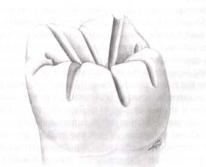
GUIDING GROOVES FOR OCCLUSAL REDUCTION

Slide 25
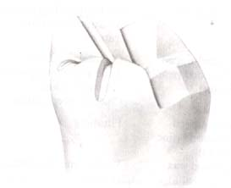
OCCLUSAL REDUCTION(occlusal reduction done maintaining the mesial or distal half as reference)

Slide 26
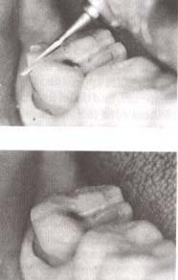
ANGULATION OF BUR WHILE GIVING FUNCTIONAL CUSP BEVEL

Slide 27
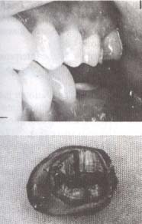
EVALUATION OF ADEQUACY OF OCCLUSAL CLEARANCE

Slide 28
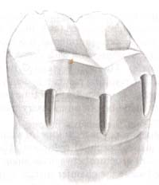
ALINGMENT GROOVES FOR BUCCAL REDUCTION

Slide 29
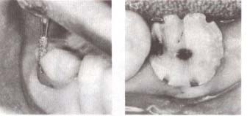
AFTER ALL SIX GROOVES ARE PLACED(see they are more deep occlusally than cervically)

Slide 30
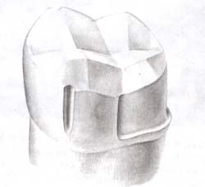
AXIAL REDUCTION(complete on one side cand compare with the other)

Slide 31
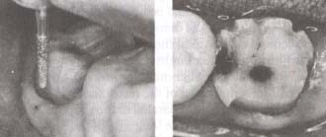
NOTE THE ALIGNMENT OF THE BUR AS TOOTH STRUCTURE BETWEEN THE ALIGNMENT GROOVE IS REMOVED

Slide 32
AXIAL REDUCTION

Slide 33
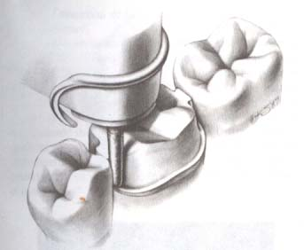
AXIAL REDUCTION IN LARGE CONTACT AREA

Slide 34
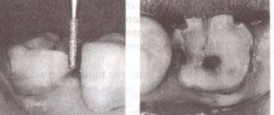
AS MESIOBUCCAL AXIAL REDUCTION IS DONE A CHAMFER IS PLACED

Slide 35
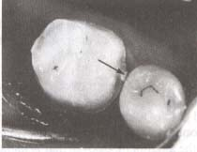
A LIP OF ENAMEL TO PROTECT THE TEETH FROM IATROGENIC DAMAGE

Slide 36
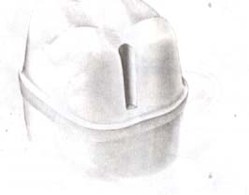
THE PLACEMENTN OF SEATING GROOVE

Slide 37
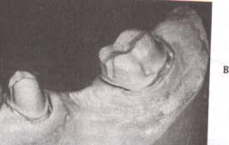

Slide 38
EVALUATION
1)OVERTAPERING OF THE SURFACE DECREASES RETENTION SO COMPENSATE FOR OT
2)NO UNDERCUTS SHOULD BE PRESENT WHEN WE PLACE THE DIAMOND AGAINST THE TOOTH SURFACE
3)ASSESS FOR PROXIMAL AND OCCLUSAL CLEARANCE TO PLACE THE RESTORATION

Slide 39
C0NCLUSION
A WELL ORGANISHED APPROACH TO PREPARE CAST CROWNS
1)PROPER PLACEMENT OF GUIDING GROOVES
2)UNIFORM TAPER OF AXIAL WALLS WITH NO UNDERCUTS
3)A SMOOTH UNIFORM CONTINUOUS CHAMFER SUPRAGINGIVAL MARGIN WHICH RESISTS THE VERTICAL DISPLACEMENT OF A EXPLORER OR PROBE

Slide 40
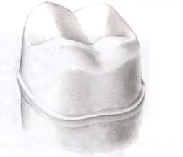
THE COMPLETE PREPARATION(smooth chamfer,6 degree taper and gradual transition between all prepared planes)INTERNAL FEATURES

Slide 41
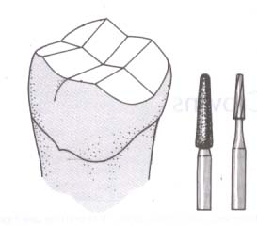
OCCLUSAL REDUCTION(round end tapered diamond 171 l bur)

Slide 42
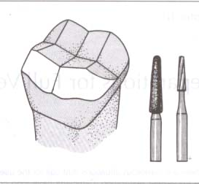
FUNCTIONAL CUSP BEVEL(round end tapered diamond bur)

Slide 43
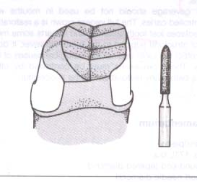
BUCCAL AND LINGUAL AXIAL REDUCTION(torpedo bur)

Slide 44
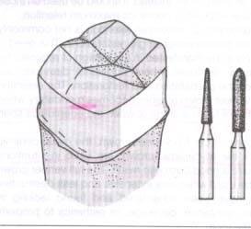
PROXIMAL AXIAL REDUCTION(short needle and torpedo diamonds)

Slide 45
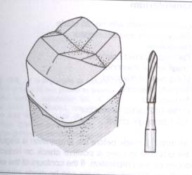
CHAMFER AND AXIAL FINISHING(torpedo bur)

Slide 46
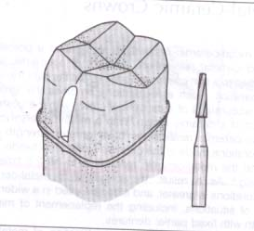
SEATING GROOVE(no 171 bur)

Slide 47
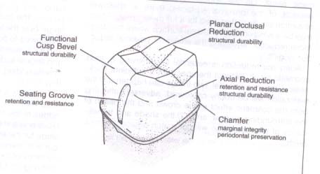
FEATURES OF MANDIBULAR FULL METAL CROWN RESTORATION

Slide 48
FEATURES
1_)PLANAR OCCLUSAL REDUCTION
2)AXIAL REDUCTION
3)FUNCTIONAL CUSP BEVEL
4)SEATING GROOVES
5)CHAMFER FINISH LINE
1)OCCLUSAL STABILITY
2)RETENTION,RESISTANCE AND STABILITY
3)STRUCTURAL DURABILITY
4)MARGINAL INTEGRITY
5)MARGINAL INTERGRITY ,PERIODONTAL PRESERVATION

Slide 49
THE METAL-CERAMIC CROWN PREPARATION

Slide 50
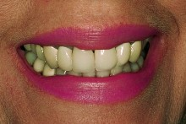
WHY IS IT CALLED METAL-CERAMIC RESTORATION OR PORCELAIN FUSED TO METAL RESTORATION?

Slide 51
TYPES OF METAL CERAMIC RESTORATION?
ANTERIOR METAL CERAMIC CROWN
POSTERIOR METAL CERAMIC CROWN

Slide 52
INDICATIONS
1)FOR MORE STRENGHT OF CROWN
2)TO DESIRE SUPERIOR MARGINAL FIT
3)IT ACTS AS RETAINERS IN RPD WHERE THE METAL SUBSTRUCTURE IS MODIFIED TO MAKE REST,RECIPROCAL GUIDE PLANES
4)IT HELPS TO CREATE OCCLUSION IN MALALIGNED TEETH
5)IT PROVIDES A PROTECTIVE FRAMEWORK FOR ENDODONTICALLY TREATED TEETH WITH A SUITABLE SUPPORTING STRUCTURE(A CAST POST CORE)

Slide 53
CONTRAINDICATIONS
1)ACTIVE CARIES AND UNTREATED PERIODONTAL PROBLEMS
2)YOUNG PATIENTS WITH LARGE PULP CHAMBER
3)WHERE CONSERVATIVE RETAINER IS FEASIBLE IT IS NOT ADVISABLE TO INVOLVE ALL THE SURFACES OF THE TEETH

Slide 54
ADVANTAGES
1)IT INVOLVES STRENGTH OF METAL AND ESTHETICS OF PORCELAIN
2)AS IT INVOLVES ALL THE AXIAL WALLS RETENTION IS GOOD

Slide 55
DISADVANTAGES
1)ADEQUATE REMOVAL OF TOOTH STRUCTURE
2)FOR BETTER ESTHETICS THE FACIAL MARGIN OF ANTERIOR RESTORATION IS PLACED SUBGINGIVALLY WHICH CAN HARM THE GINGIVAE
3)INFERIOR ESTHETICS COMPARED TO ALL CERAMIC CROWN
4)THE GLASS LIKE NATURE OF VEENERING MATERIAL MAKES IT BRITTLE
5)DIFFICULTY IN SHADE SELECTION
6)LAB CHARGES ARE HIGH FOR PORCELAIN APPLICATION AND METAL CASTING

Slide 56
PREPARATION FOR ANTERIOR METAL-CERAMIC FULL VENEER CROWNS

Slide 57
ARMAMENTARIUM
LAB KNIEF WITH NO 25 BLADE
SILICON PUTTY AND ACCLERATOR
HANDPIECE
SMALL WHEEL DIAMOND
LONG NEEDLE DIAMOND
TORPEDO DIAMOND
TORPEDO BUR
H158-012 RADIAL FISSURE BUR
RS1 BIANGLE CHISEL

Slide 58
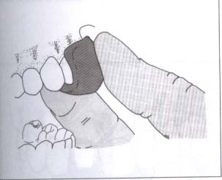
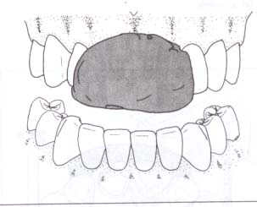
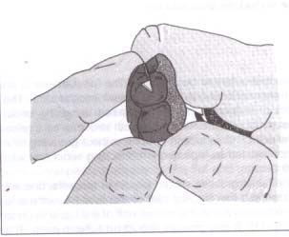
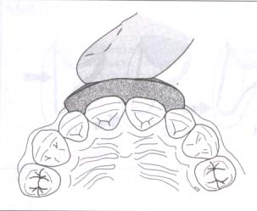
PREPARATION OF INDEX

Slide 59
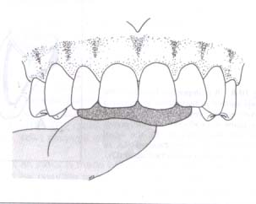
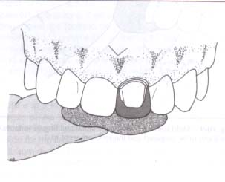

Slide 60
ACCORDING TO “ESTHETICS OF ANTERIOR FIXED PROSTHODONTICS”
TOOTH PREPARATION IS DICTATED BY 3 IMPERATIVES
1)LENGTH OF PRE FOR RETENTION AND RESISTANCE
2)THICKNESS OF CERAMIC VENEER FOR ESTHETICS
3)OCCLUSAL CLEARANCE FOR OCCLUSAL FUNCTION AND ANTERIOR GUIDANCE

Slide 61
A THICK TOOTH WITH MINIMUM TAPER AND CONVEXITY,RETRACTED PULP ,LARGE HORIZONTAL OVERLAP AND SHALLOW VERTICAL OVERLAP IS FAVOURABLE FOR REDUCTION
THIN TOOTH WITH SEVERE CONVEXITY AND TAPER,LARGE PULP,SMALL HORIZONTAL BUT LARGE VERTICAL OVERLAPMAKES PREPARATION DIFFICULT

Slide 62
STEIN STATED THAT….
ONE PLANE LABIAL REDUCTION
1)CLOSE TO PULP
2)OVERTAPERING OF PREP
3)OVERCOUNTOURING
REFERENCES
1)FACIAL CONVEXITY OF THE TOOTH
2)ADJACENT TEETH

Slide 63
PRECISION OF PREPARATION
USE BURS OF KNOWN DIAMETER
FOLLOW A DEFINITE PATTERN OF ENAMEL REMOVAL
ESTABLISH SHOULDER DEPTH AT AN EARLY STAGE
MEASURE THE DIMENSIONS OF PROVISIONAL BEFORE IMPRESSION TO KNOW THAT THE PREPPARATION WAS ADEQUATELY REDUCED

Slide 64
LABIAL REDUCTION

Slide 65
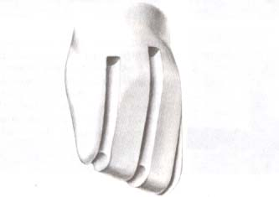

Slide 66
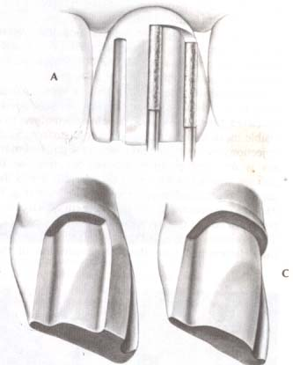
THE CERVICAL SHOULDER IS MADE AS THE TOOTH STRUCTURE BETWEEN THE GROOVES IS REMOVED

Slide 67
FACIAL REDUCTION DONE IN TWO PLANES

Slide 68
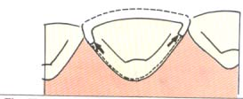
WING FORMATION AT THE JUNCTION OF THE FACIAL AND LINGUAL SURFACES

Slide 69
THE BUR SHOULD BE HELD PERPENDICULAR TO THE INCISAL HALF OF THE LABIAL SURFACE

Slide 70
THE INCISAL REDUCTION IS USEFUL IN…..
IMPROVING THE INSTRUMENTS ACCESS NEAR THE AXIAL SURFACES
IMPROVING THE ACCESS FOR PLACEMENT OF THE GINGIVAL FINISH LINE
IMPROVING THE INCISAL TRANSLUCENCY IN THE FINISHED RESTORATION

Slide 71
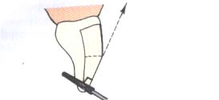

Slide 72
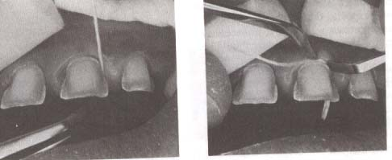
BREAKING PROXIMAL CONTACT AND PROXIMAL REDUCTION

Slide 73
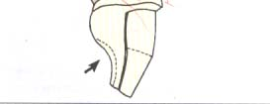
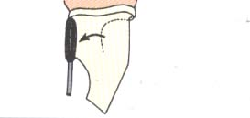
LINGUAL REDUCTION

Slide 74
A LONG NEEDLE IS USED TO BREAK THE CONTACT
THE PROXIMAL SURFACE IS MADE WITH TORPEDO BUR
THE LINGUAL CHAMFER FINISH LINE IS OBTAINED BY TIP OF TORPEDO BUR

Slide 75
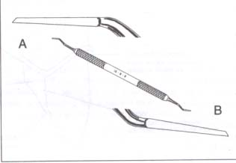
THE BIANGLE CHISEL USED TO FINISH THE RADIAL SHOULDER

Slide 76
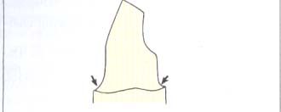
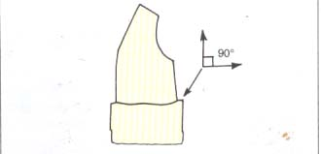
THE DIFFERENT MARGINS

Slide 77
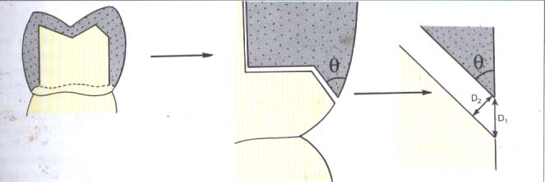
THE IMPORTANCE OF BEVEL….

Slide 78
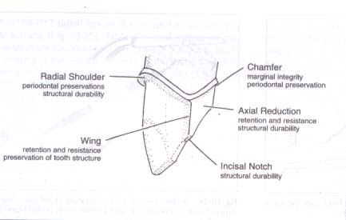
THE COMPLETE PREPARATION

Slide 79
FEATURES
1)RADIAL SHOULDER
2)CHAMFER
3)AXIAL REDUCTION
4)INCISAL REDUCTION
5 )WING
FUNCTION
Structural durabilitry,perio preservation
2)marginal intergrity
3)retention and resistance
4)structural durability
5)retention,resistance and preservation of tooth structure

Slide 80
POSTERIOR METAL CERAMIC CROWNS

Slide 81
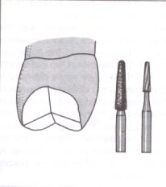
PLANAR OCCLUSAL REDUCTION(round end tapered diamond bur and no 171 l)

Slide 82
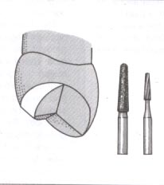
FUNCTIONAL CUSP BEVEL(round end tapered bur)

Slide 83
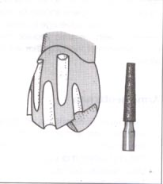
DEPTH ORIENTATION GROOVES;(flat end tapered diamond)

Slide 84
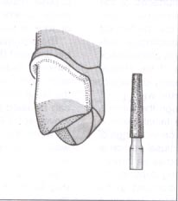
FACIAL REDUCTION,GINGIVAL HALF(flat end tapered diamond)

Slide 85
PROXIMAL AXIAL REDUCTION(:short needle diamond)

Slide 86
FACIAL AXIAL AND RADIAL SHOULDER FINISHING(radial fissure bur and shoulder bevel is given by flame shaped diamond and h148-010 carbide finishing bur)

Slide 87
GINGIVAL BEVEL(flame diamond and finishing bur)

Slide 89
MAKING OF A GOOD FIXED PARTIAL PROSTHESIS INVOLVES METICULOUS PRACTICE AND PROPER KNOWLEDGE OF TOOTH PREPARATION

Slide 90
summary
Precision attachments serve the function of retention, stress distribution and aesthetics successfully. Appropriate selection of attachments, plays a major role in the success of treatment.
Use of precision attachment strengthens the aspects of retention and particularly, esthetics when compared to conventional removable partial dentures.

Slide 91
TAKE HOME MESSAGE
The clinicians who familiarize himself with precision attachments will add a new dimensions to his treatment options
Proper maintenance and care by the patient and regular follow up decides on the long term success of the attachment and prosthesis.

Slide 92
BIBLIOGRAPHY
FUNDAMENTALS OF FIXED PROSTHODONTICS:T SHILLINBURG:3 rd EDITION:PAGE 346-379
CONTEMPORARY FIXED PROSTHODONTICS:2 nd EDITION:ROSENSTIEL:250-270

Slide 93
SUGGESTIVE READING

Slide 94
QUESTIONS
DESCRIBE THE BIOMECHANICAL CONSIDERATION OF THE TOOTH PREPARATION FOR FPD.
MENTION THE PRINCIPLES OF THE TOOTH PREPARATION AND DISCUSS HOW YOU OBTAIN RENTENION AND RESISTANCE FORM.
SHORT ANSWER.
FINISHING LINE OF PREPARED TOOTH
MARGINAL INTEGRITY
RESISTANCE AND RETENTION FORM IN TOOTH PREPARATION.

